Slide 1

Mongo DB

Slide 2
Commands
Command | Description | Example
mongodb | open server mongodb
Mongo | open mongo shell
db | show databases
use database_Name | use database or create it and follow it by insert
show databases | Show database
db.collection | Make collection | db.user
 | Insert Record | db.employees.insert({"name":"ahmed"})
db.dropDatabase() | drop database
db.createCollection(name,options) | name of collection & options for max size,.... | db.createCollection("emp")
db.collection.drop() | drop database | db.emp.drop()
db.collection.find() | find records

Slide 3
Commands
Command | Description | Example
db.user.find().pretty() | Find records in pretty form.
show collection | show all collections
db.update | Update values | db.user.update({"name":"Amr"},{$set:{age:40}})
db.collection.update | Imcrement the value in age +10 | db.user.update({"name":"Amr"},{$inc:{age:10}})
 | Remove this value | db.user.update({"name":"Amr"},{$unset:age:30}})
$lt -> lower than $gt -> greater than $lte -> lower than or equal $gte -> greater than or equal $or -> select _ or _ | Select | db.employees.find({age:{$lt:30}}).pretty

Slide 4
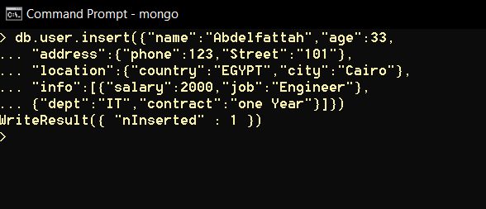
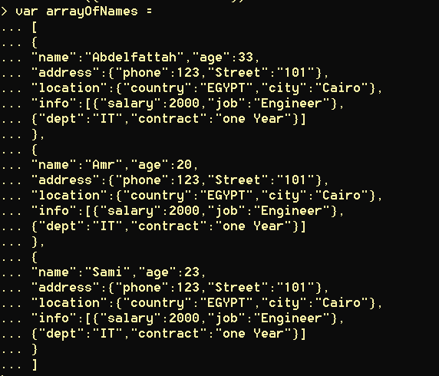
Examples
Insert Record
array with values

Slide 5
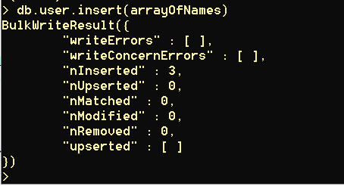

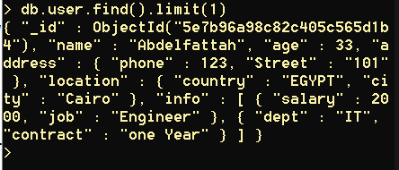
Examples
Insert array with values
Remove all values in the record include {“age”:20}
db.user.find().limit(1)

Slide 6
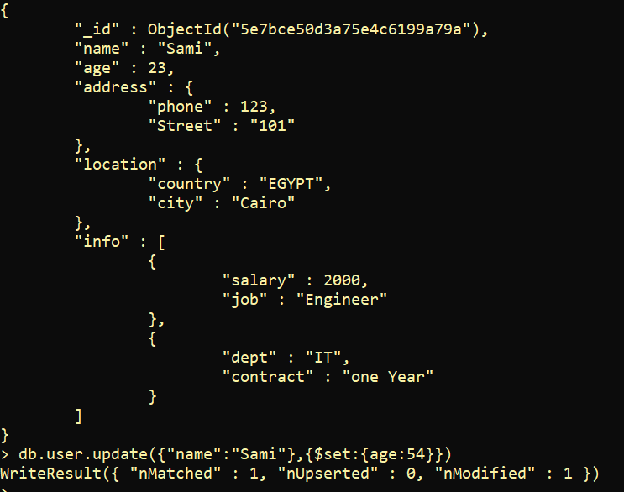
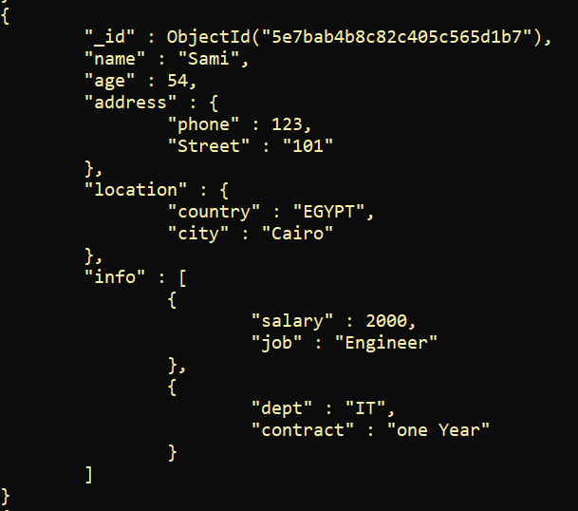
Examples
Update the record & copy it with all values

